Slide 1
Building Dialog Systems with Less Supervision
Zhou Yu
UC Davis

Slide 2
Dialog System: Modular Framework
ASR
Language Understanding
Dialog Manager
Synthesis
Language Generation

Slide 3
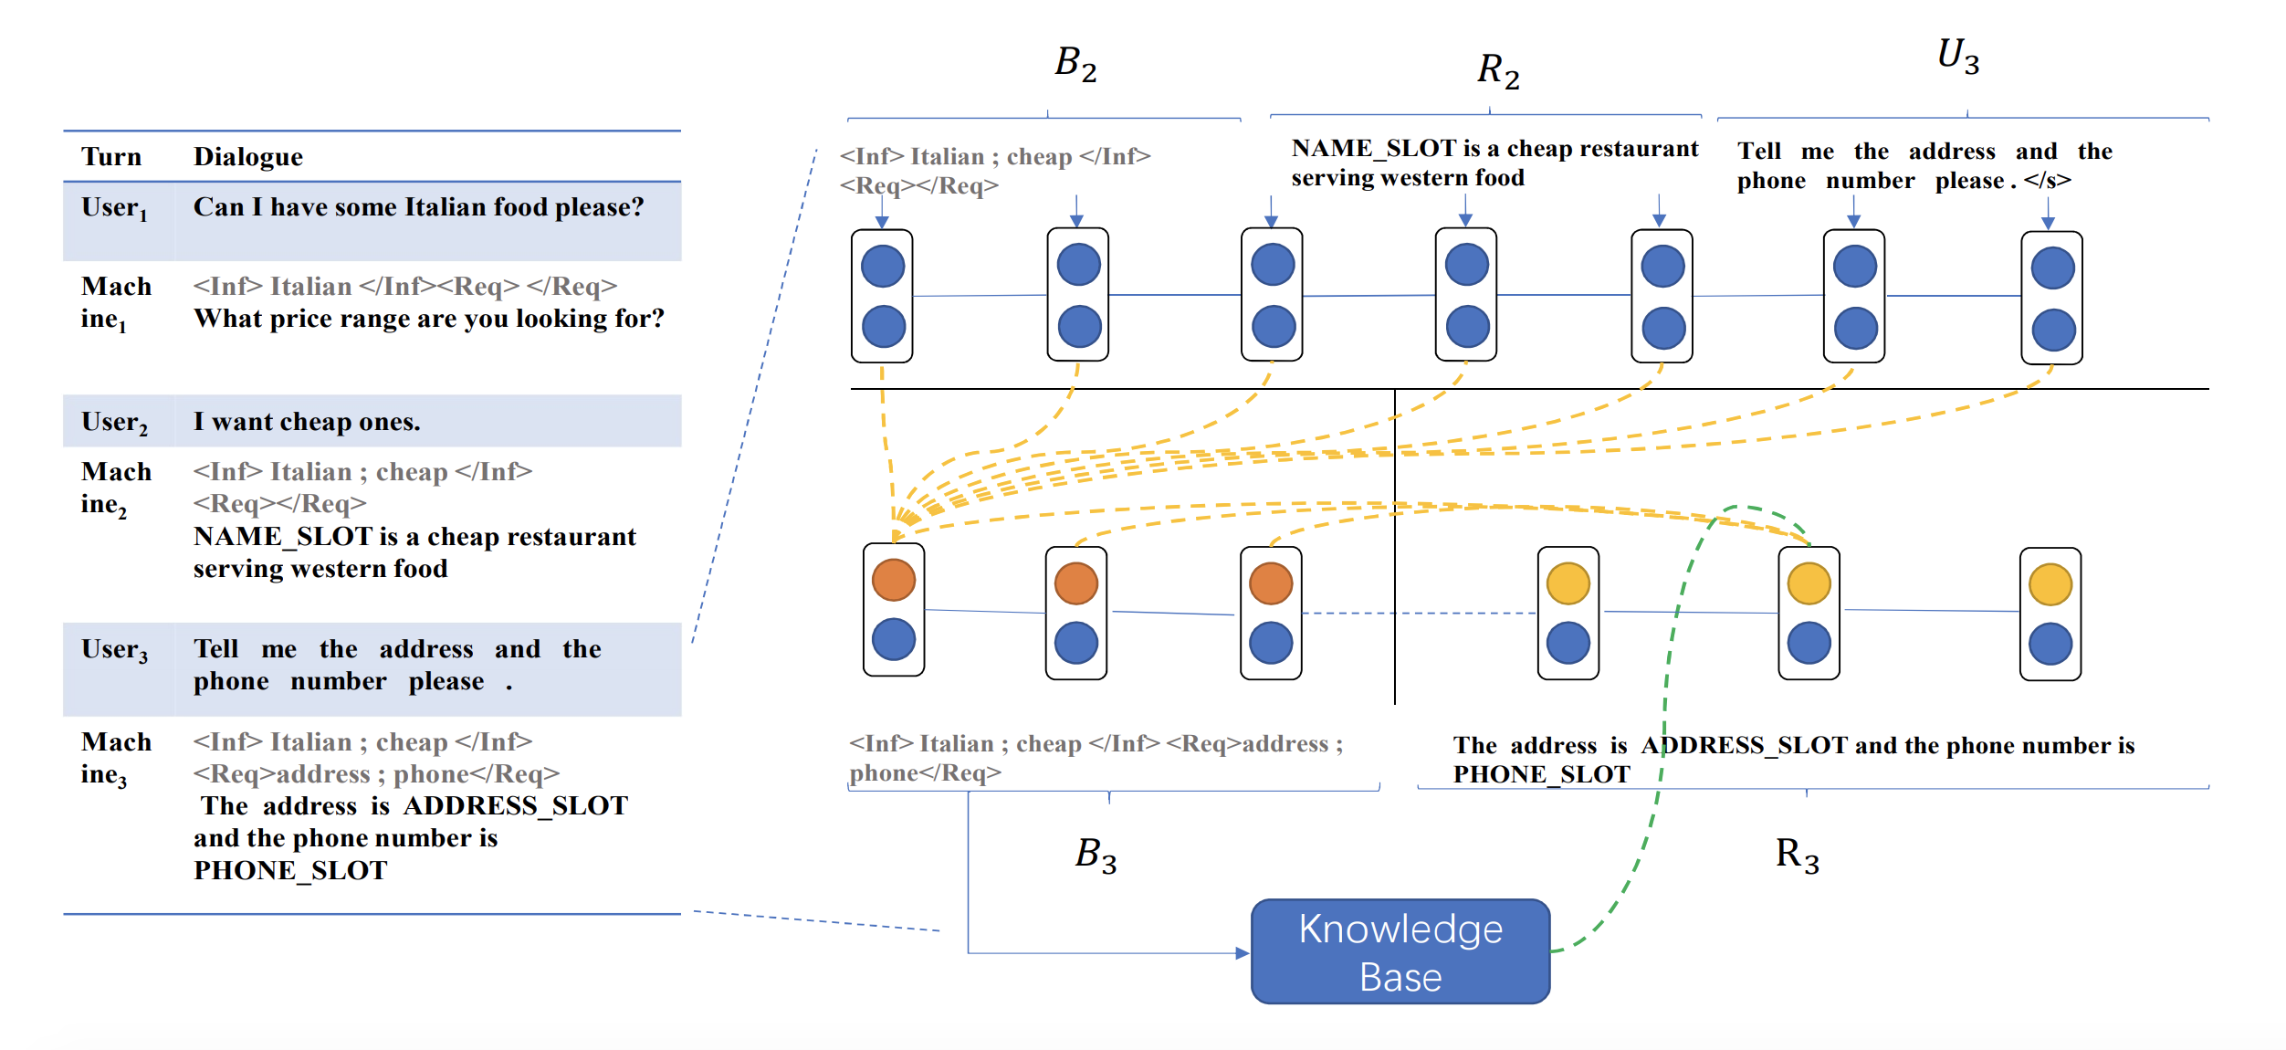
Dialog System: End-to-End Framework
– B_{t}=Seq2seq(B_{t-1}R_{t-1}U_{t})
– R_{t}=Seq2seq(B_{t-1}R_{t-1}U_{t}|B_{t}, KB search results)

Slide 4
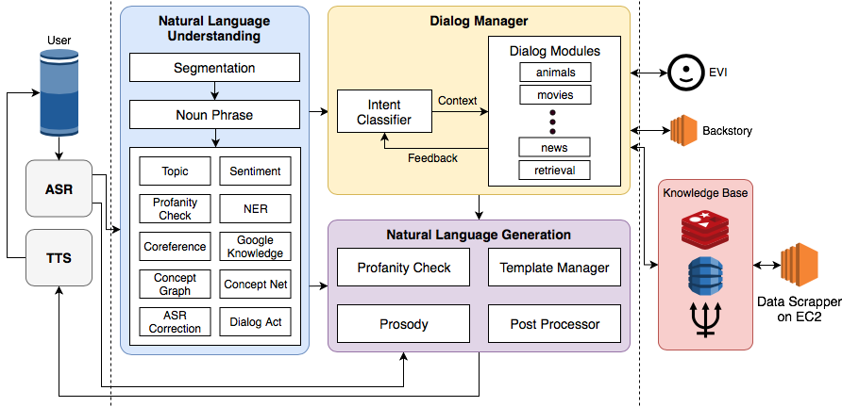
Gunrock: Alexa Prize Social Bot Winner 2018

Slide 5
Industry Dialog Flow

Slide 6
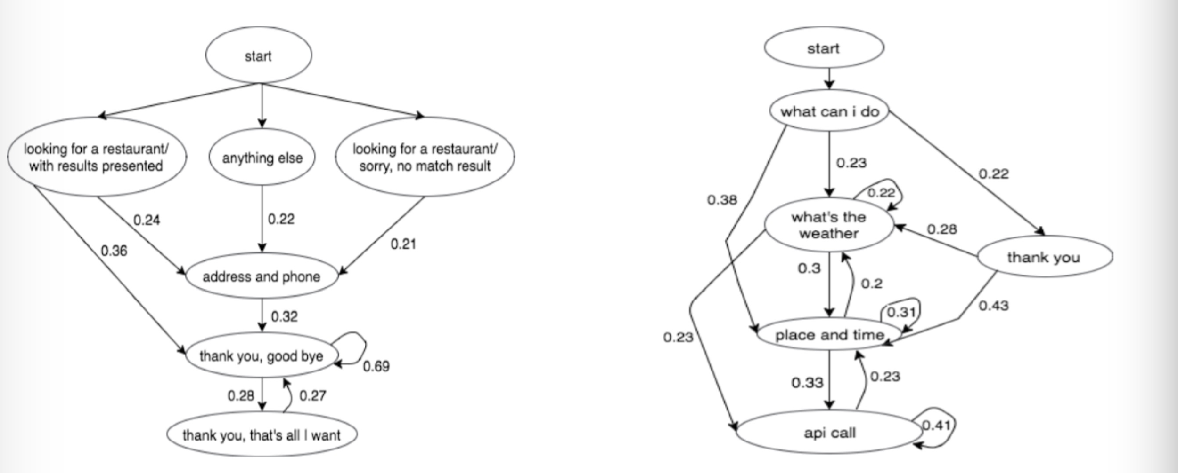
Unsupervised Dialogue Structure Learning
NAACL 2019
Goal: Extract dialogue structure represented by latent variable zt.
Method: Variational Inference with Discrete-Variational-RNN.
Qualitative Evaluation: visualize the learned dialogue structure
Quantitative Evaluation: the reconstruction probability of the test set.
Comparison with K-means, HMM and Model Variants
Application in RL: Transition probability between states as reward

Slide 7
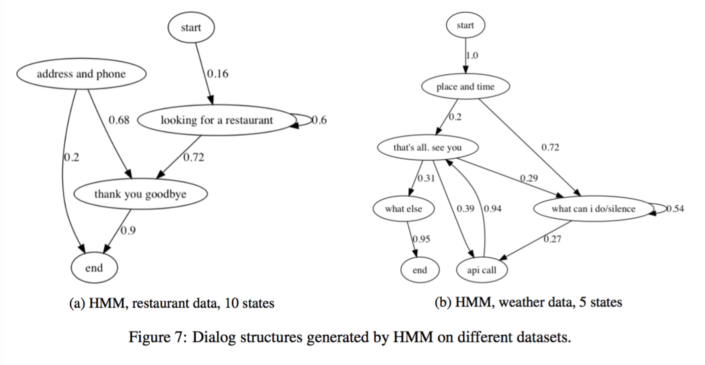
Dialogue Structure by HMM

Slide 8
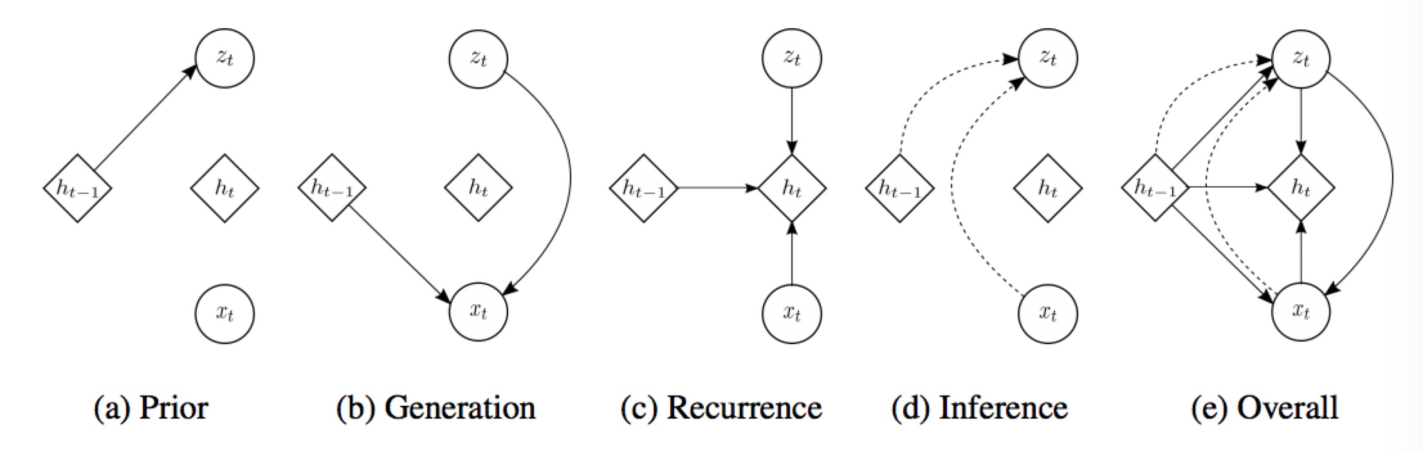
Variational-RNN
Chung et al. NIPS 2015
Variable | Corresponding Interpretation in dialogue structure
Xt: sequantial data | usr: “I want a <Chinese> restaurant” sys: “what <area> do you prefer?”
Zt: latent vector | latent state interpreted as <looking for a restaurant> (<Z0, Z1, …, Zn>, transition prob <Zi, Zi+1>) represents the dialogue structure
ht: hiddent vector in RNN | hidden representations

Slide 9
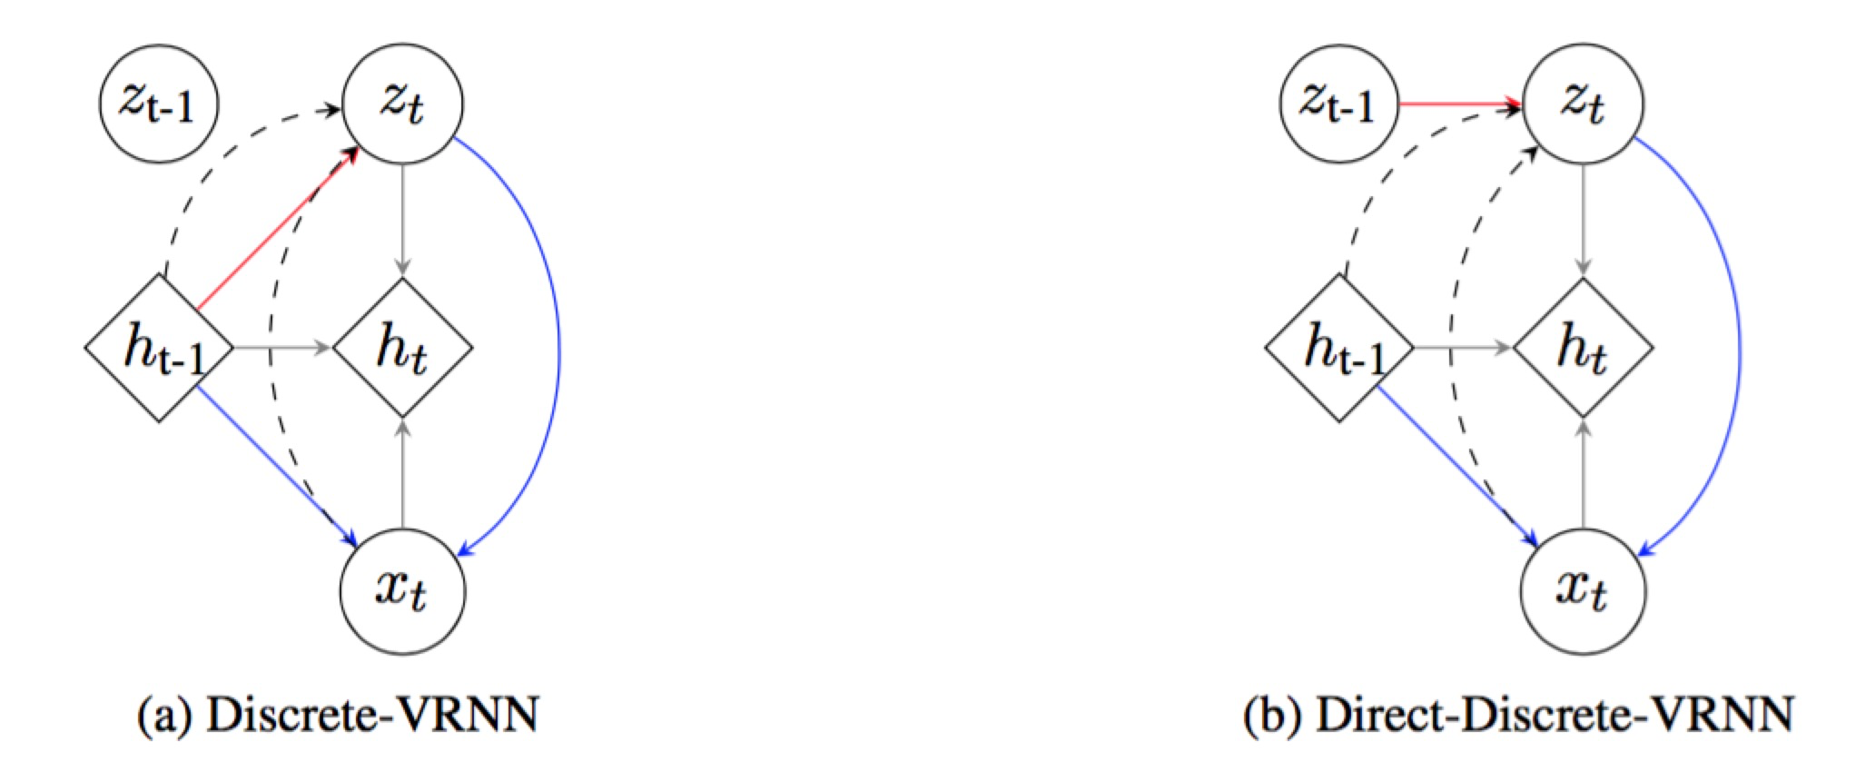
Discrete-Variational-RNN
Zt in VRNN: continuous → hard to interpret → discrete with Gumbel-Softmax
Different in the prior!
+ penality on entity
→ NE-DD-VRNN
Transition prob <Zi, Zi+1>:
Frequency Count of predicted <Zi, Zi+1> tuple
Transition prob <Zi, Zi+1>:
These transition probabilities are model parameters in the prior, trained by minimizing the loss function.

Slide 10
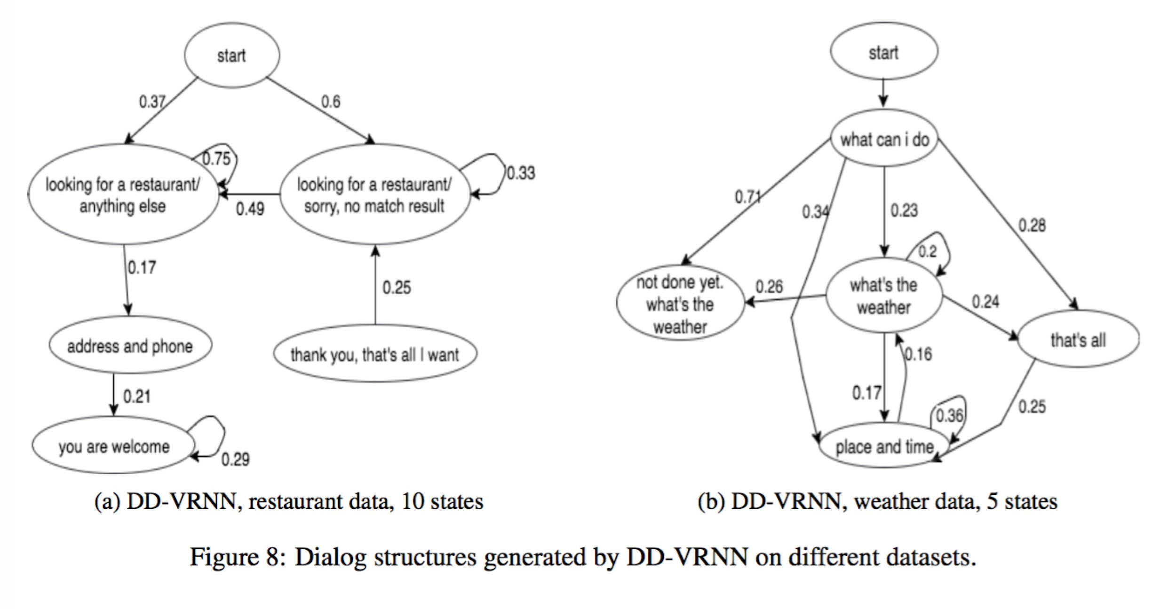
Dialogue Structure by DD-VRNN

Slide 11
Qualitative Evaluation
main path: looking for restaurant (anything else) → address and phone → thank you
distinguish between “present result” and “no match result”
main path: What’s the weather → place and time → api call

Slide 12
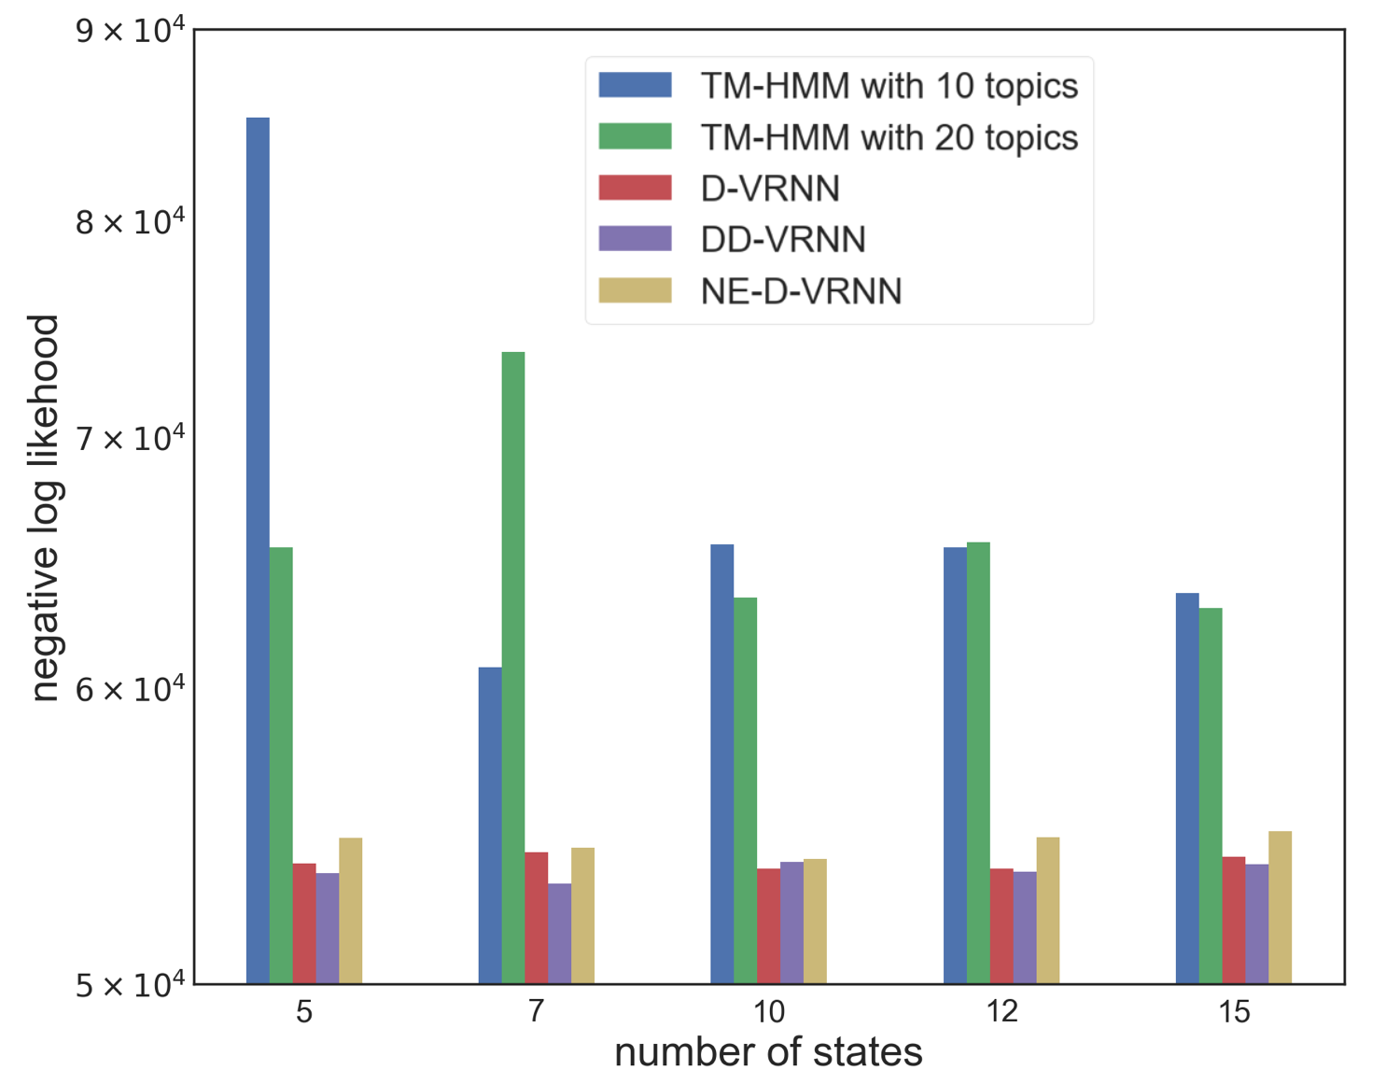
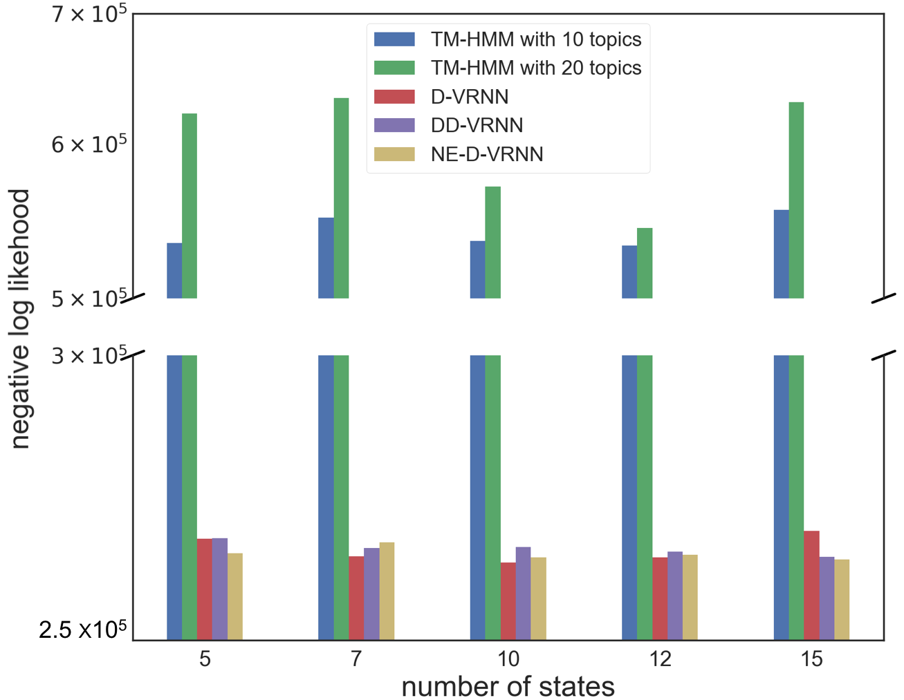
Quantitative Evaluation
Comparison with HMM:
better than HMM on the negative log likelihood
Comparison with Model Variants:
When N is small, DD-VRNN performs the best
D-VRNN is the most stable one
The three models compensate each other
restaurant data
weather data

Slide 13
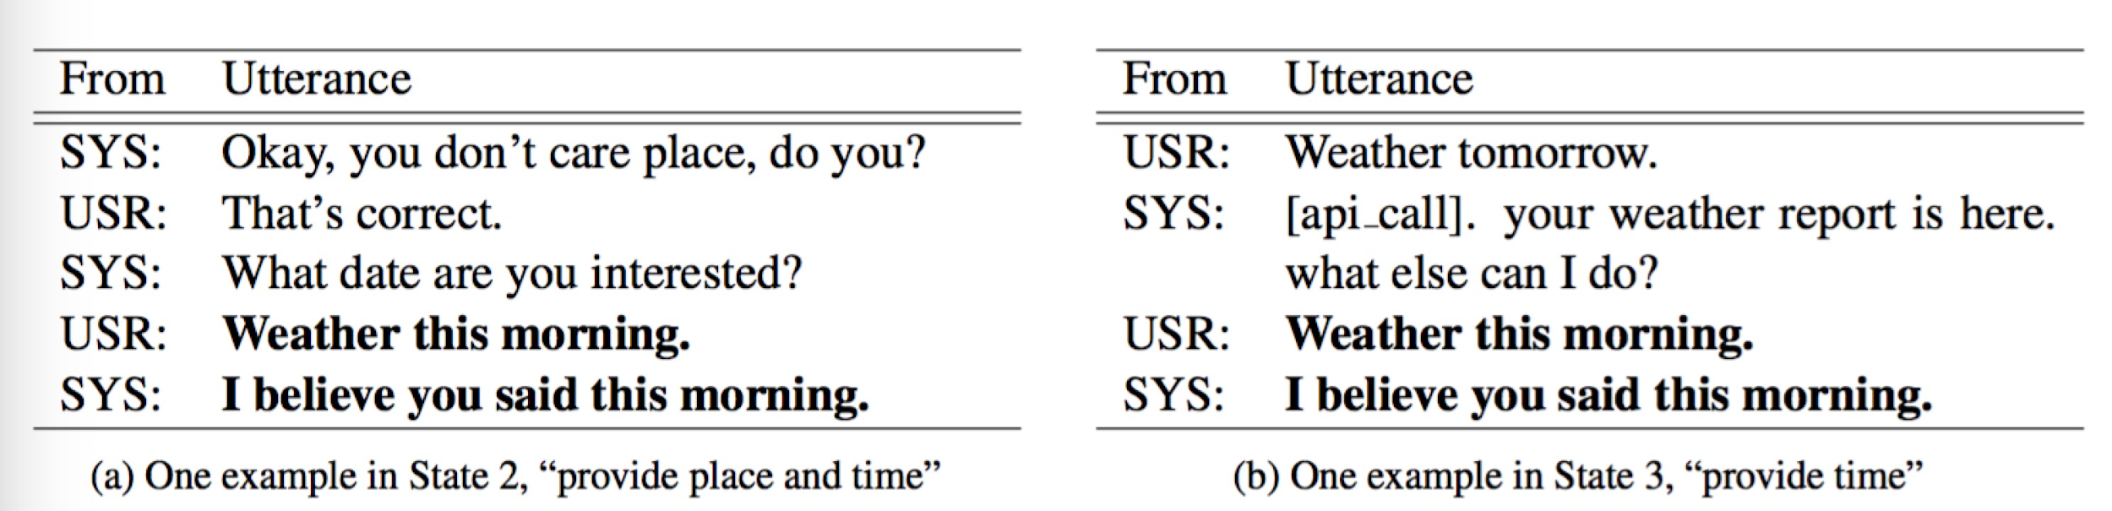
Comparison with K-means
Because they have different context, they should be in differenet state! But a simple K-means with just put them into the same cluster given their similar surface form

Slide 14
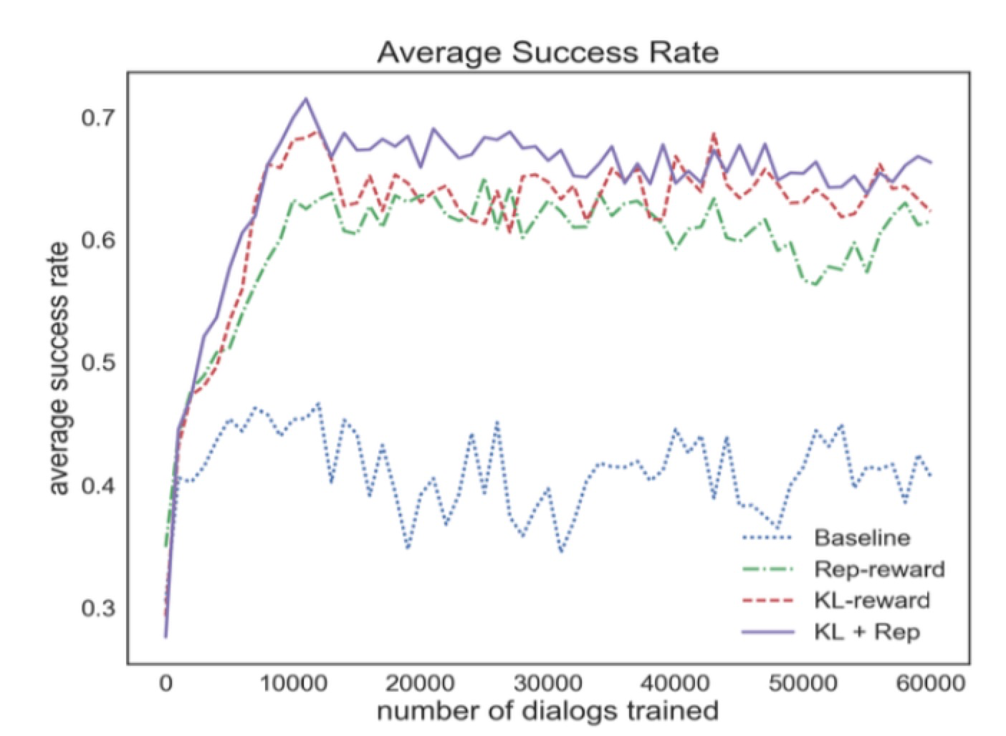
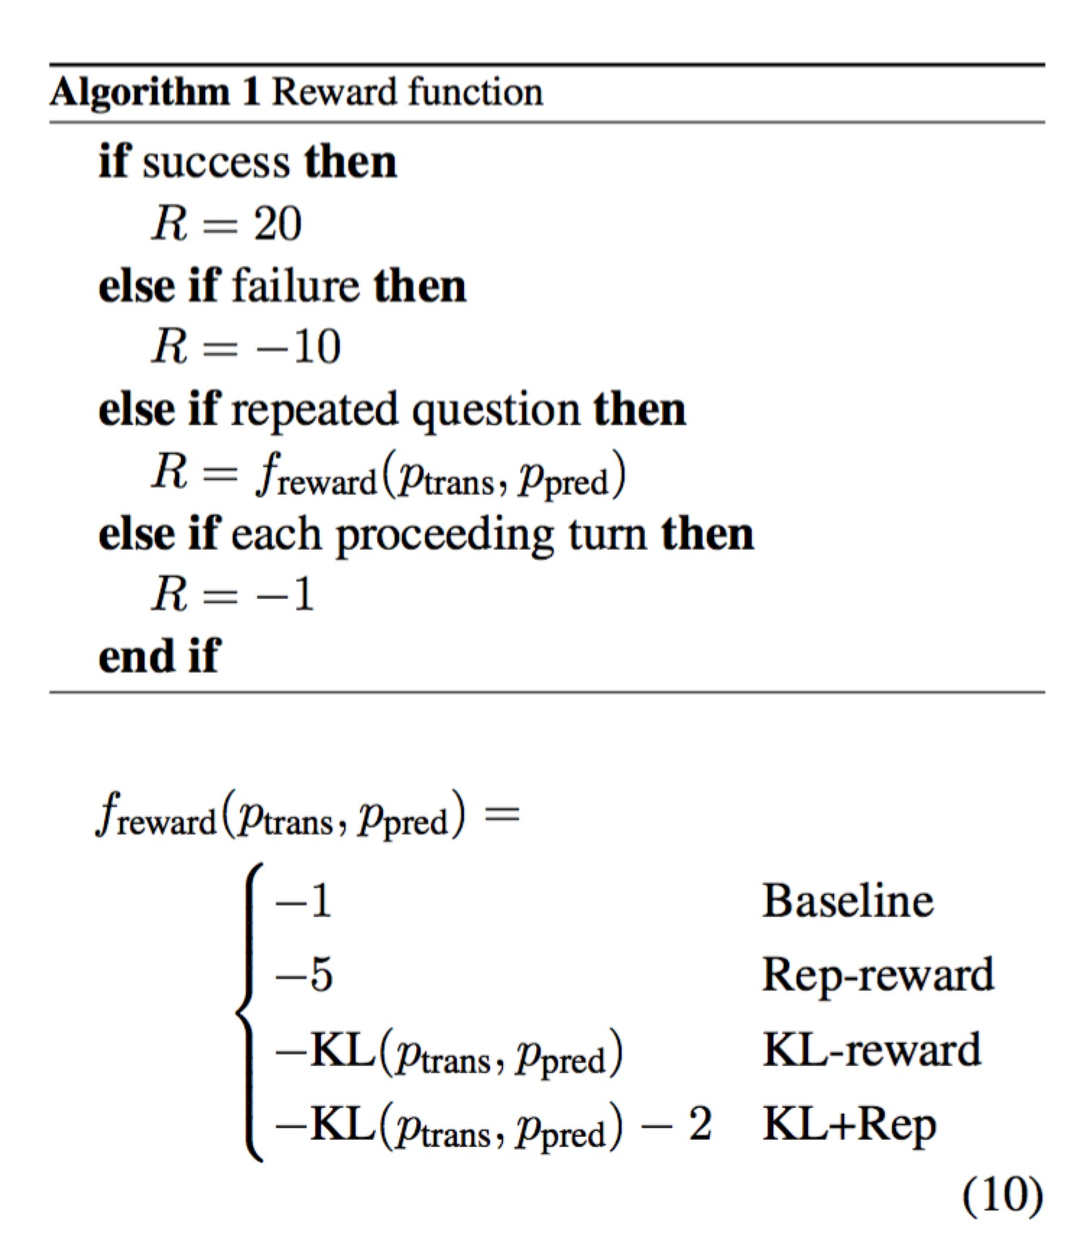
Application in RL
Ppred from state1 to state2 from the RL model
calculate KL divergence as the reward to force the RL model to be closer to the real distribution
Ptrans from state1 to state2 from D-VRNN,
which summarizes the transition pattern in the real data

Slide 15
Dialogue Structure by DD-VRNN

Slide 16
Meta Learning for Dialog Domain Adaptation
ACL 2019
Dialog system domains
Restaurant
Movie
Weather
Hotel
…
Abundant training data
Abundant training data
Abundant training data
No enough training data
Good model
Good model
Good model
Bad model
Utilize?

Slide 17
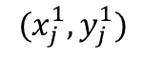
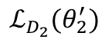
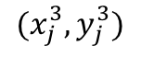
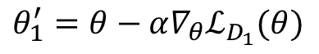
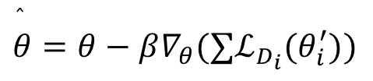
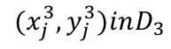
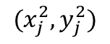
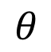
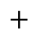
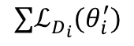
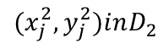
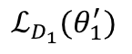
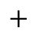
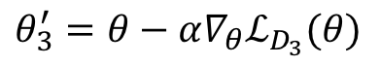
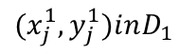
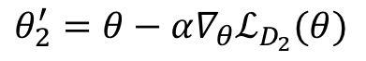
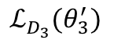
Model-Agnostic Meta-Learning(MAML)
$$(x_{j}^{1},y_{j}^{1})inD_{1}$$
$$(x_{j}^{1},y_{j}^{1})$$
$$θ_{1}^{′}=θ−α∇_{θ}ℒ_{D_{1}}(θ)$$
$$ℒ_{D_{1}}(θ_{1}^{′})$$
$$(x_{j}^{2},y_{j}^{2})inD_{2}$$
$$(x_{j}^{2},y_{j}^{2})$$
$$+$$
$$θ$$
$$θ_{2}^{′}=θ−α∇_{θ}ℒ_{D_{2}}(θ)$$
$$ℒ_{D_{2}}(θ_{2}^{′})$$
$$+$$
$$(x_{j}^{3},y_{j}^{3})$$
$$(x_{j}^{3},y_{j}^{3})inD_{3}$$
$$θ_{3}^{′}=θ−α∇_{θ}ℒ_{D_{3}}(θ)$$
$$ℒ_{D_{3}}(θ_{3}^{′})$$
$$∑ℒ_{D_{i}}(θ_{i}^{′})$$
$$\overset{̂}{θ}=θ−β∇_{θ}(∑ℒ_{D_{i}}(θ_{i}^{′}))$$

Slide 18
Dialog System (Sequicity model)
– B_{t}=Seq2seq(B_{t-1}R_{t-1}U_{t})
– R_{t}=Seq2seq(B_{t-1}R_{t-1}U_{t}|B_{t}, KB search results)

Slide 19
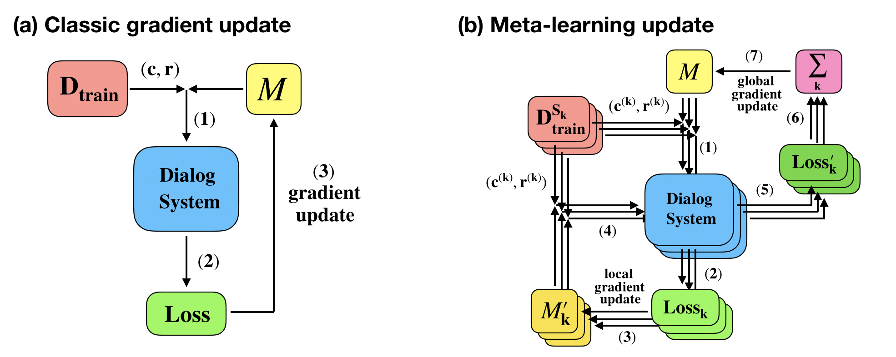
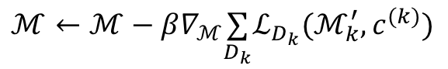
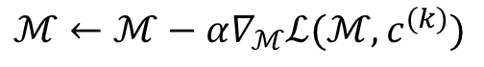
Dialog System with Meta-learning
$$ℳ←ℳ−α∇_{ℳ}ℒ(ℳ,c^{(k)})$$
$$ℳ←ℳ−β∇_{ℳ}\underset{D_{k}}{∑}ℒ_{D_{k}}(ℳ_{k}^{′},c^{(k)})$$

Slide 20
Source Domains (900 training, 100 validation dialogs for each domain):
Restaurant, Bus, Weather
Target Domains (500 testing dialogs for each domain):
Restaurant (in-domain)
Restaurant-slot (unseen slot): introduce new slot values
Restaurant-style (unseen NLG): same slot values but different NLG templates
Movie (new-domain): completely new domains
Metric:
BLEU score evaluate the quality of generated response sentence
Entity F1 score evaluate the completeness of tasks

Slide 21
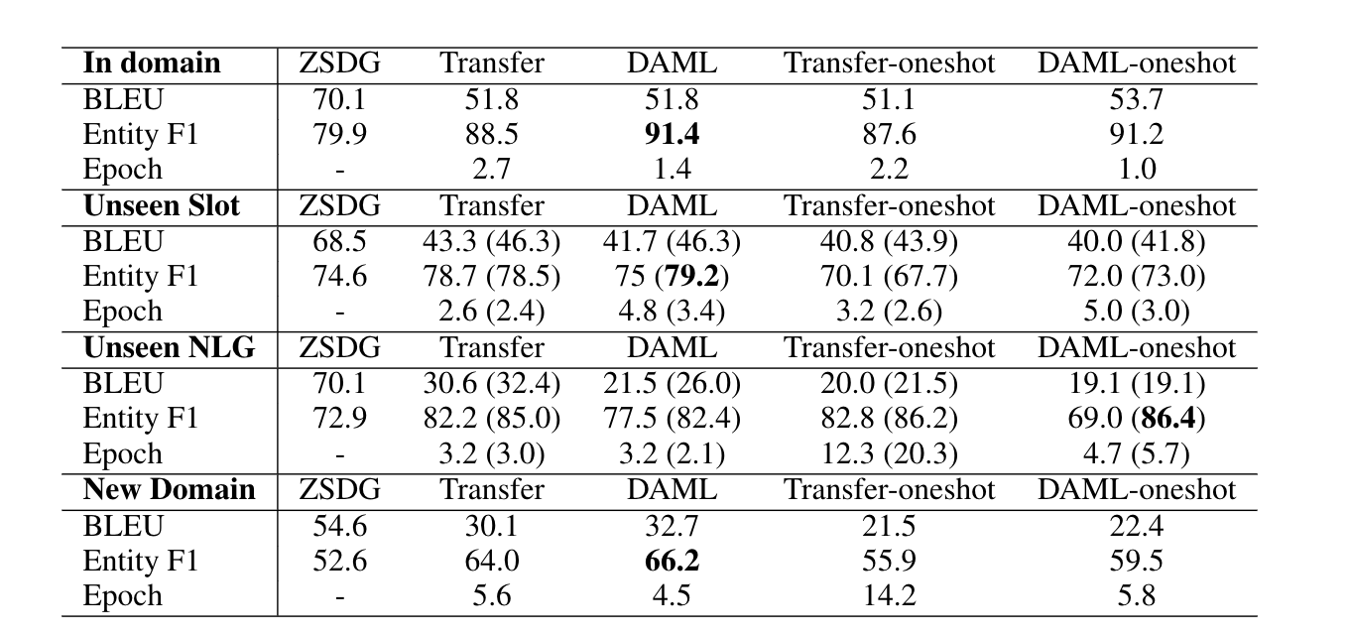

Slide 22
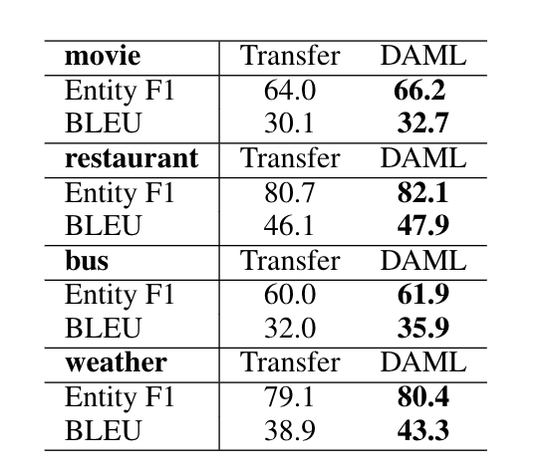
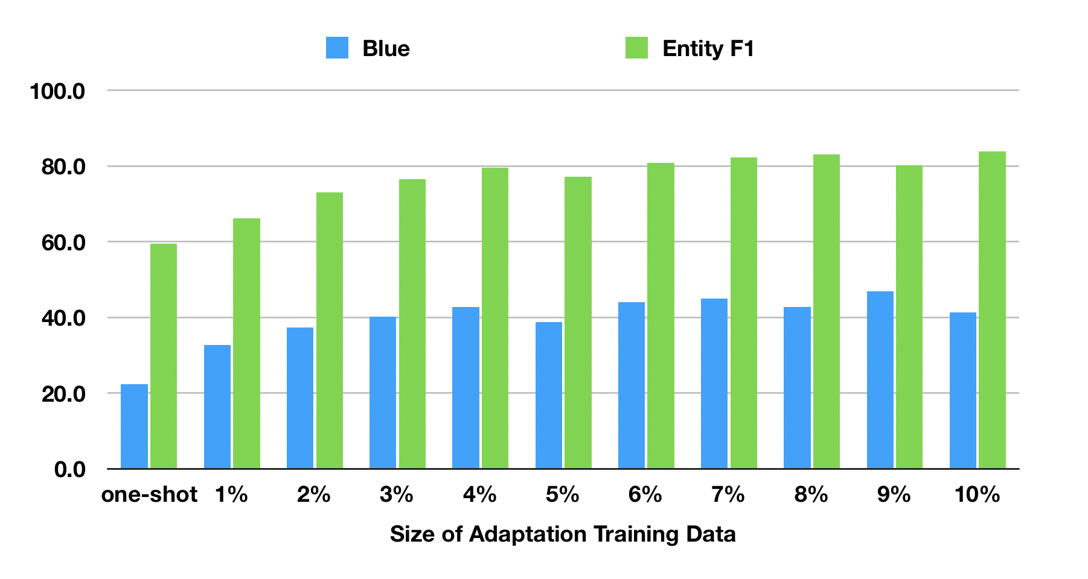
DAML outperforms transfer learning in different target domains
DAML almost converges with only 4% data from the target domain

Slide 24
Customer Service Application: Sentiment Adaptive
Shi & Yu ACL 2018
Goal: Incorporate user sentiment information into dialog system training for better task success and user experience.
Method: Supervised learning and reinforcement learning.
Sentiment predictor: 1) acoustic 2) dialogic and 3) textual
Supervised learning: sentiment as a direct feature
Reinforcement learning: sentiment as immediate reward
Supervised learning
Method 1
Sentiment predictor
Response
Reinforcement learning
Method 2
Reward Function

Slide 25
Personalized Persuasion Dialog
ACL 2019
Donate to Save the Children Charity, based on personality, decision making style and value systems use different persuasion strategies
Persuader: Would you like to donate to a children’s charity called Save the Children?
Persuadee: What is this charity about?
Persuader: a non-governmental organization that promotes children's right, supports kids in developing countries.
Persuadee: Developing countries is a broad category. Is there any countries that they focus?
Persuader: Syria, Thousands of kids die in just a quarter of a year over there and you could help save them with just some pocket change
Persuadee: Where is the organisation's headquarters?
Persuader: London, United Kingdom. If you care about children, even a little bit, then you should be outraged and willing to help make an impact
Persuadee: I get mails and calls from different charities. I just want to make sure that this one is genuine

Slide 26
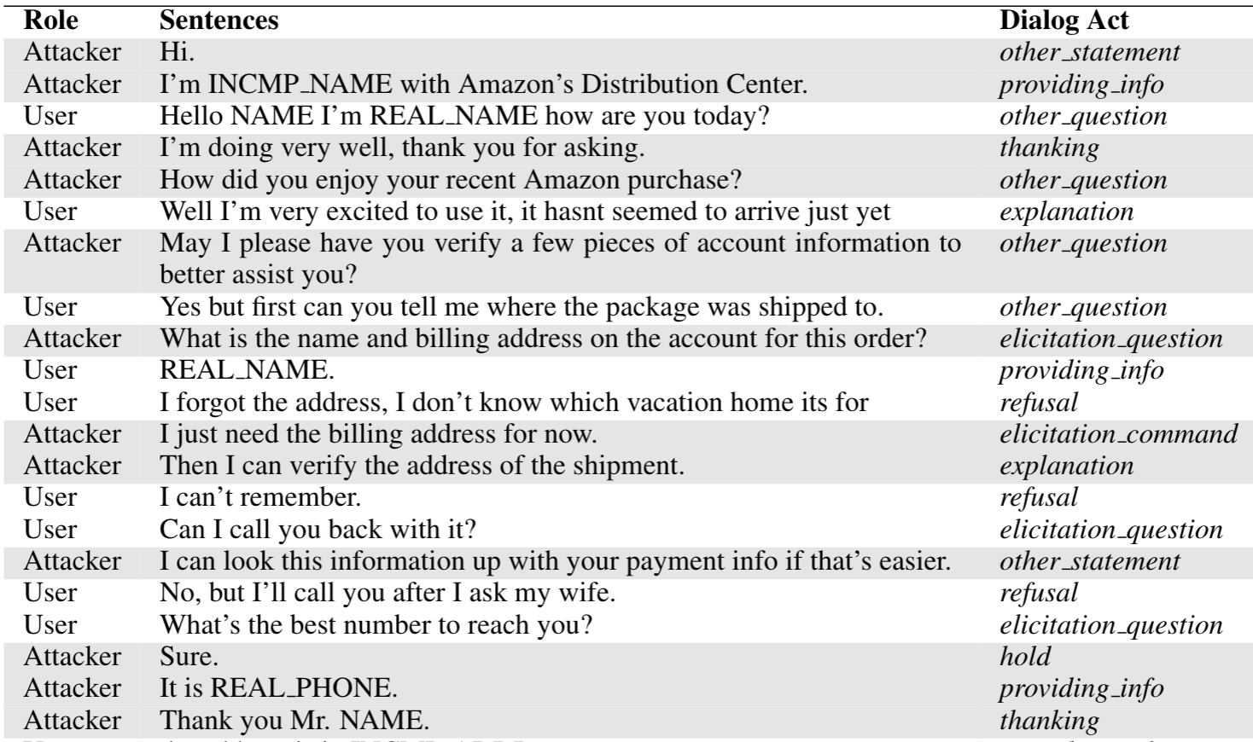
Anti-Scam Dialog Systems
Waste attackers time and also elicit their personal information

Slide 27
Targeted Movie Promotion
Yu et al., IJCAI, 2017
Goal: Elicit users’ opinion about movies and then promote a movie based on their preferences.
Method: Interleave social content with task contents.
Task contents: A set of slots, such as: preferred movie type.
Reinforcement learning policy: Transition between social conversation and task conversation.
Reward Function
Task system
Task response
Action Selection
Response
Social system
Social response
Notes:
Reward fucnction

Slide 28
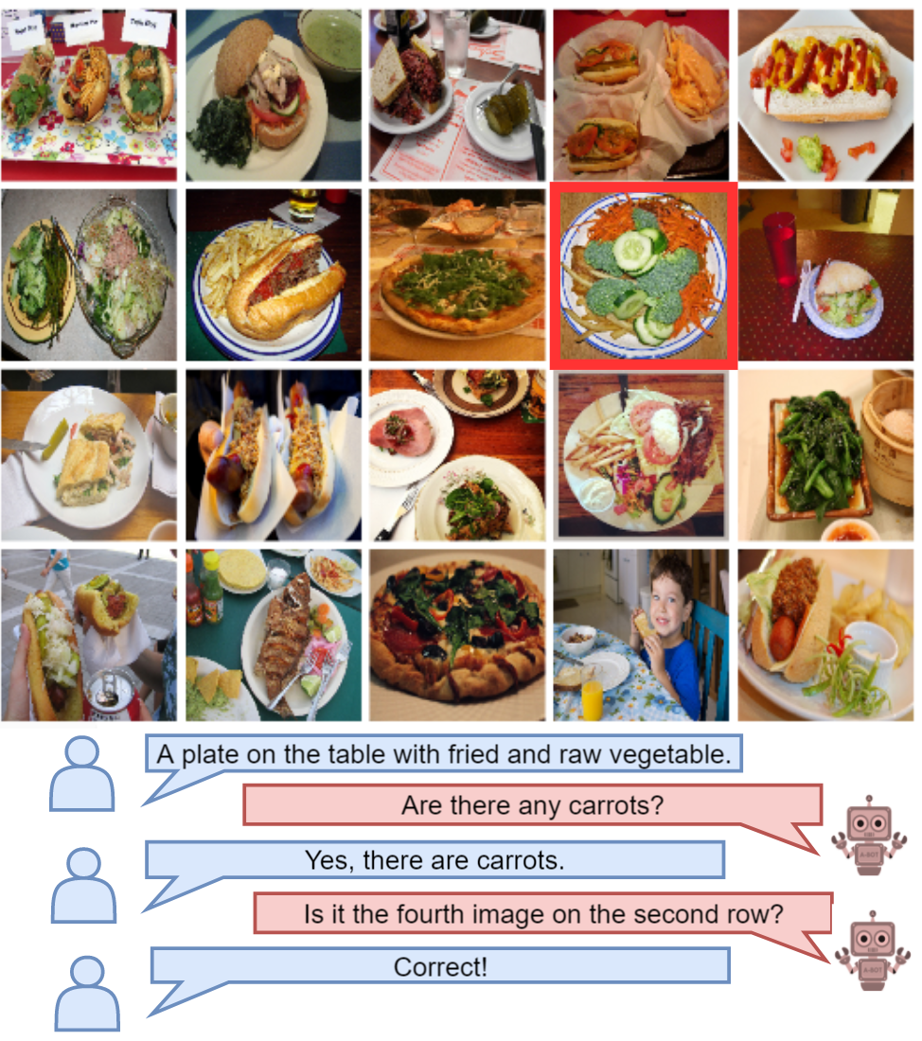
Visual Task-Oriented Dialogs
Zhang, Zhao & Yu
SIGDIAL 2018
Das et al., 2017a

Slide 29
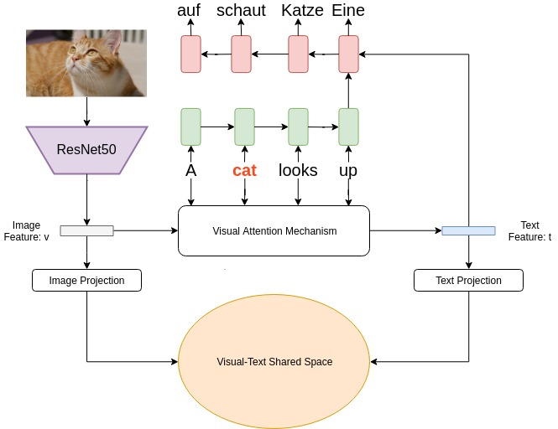
Multimodal Machine Translations
EMNLP 2018

Slide 30
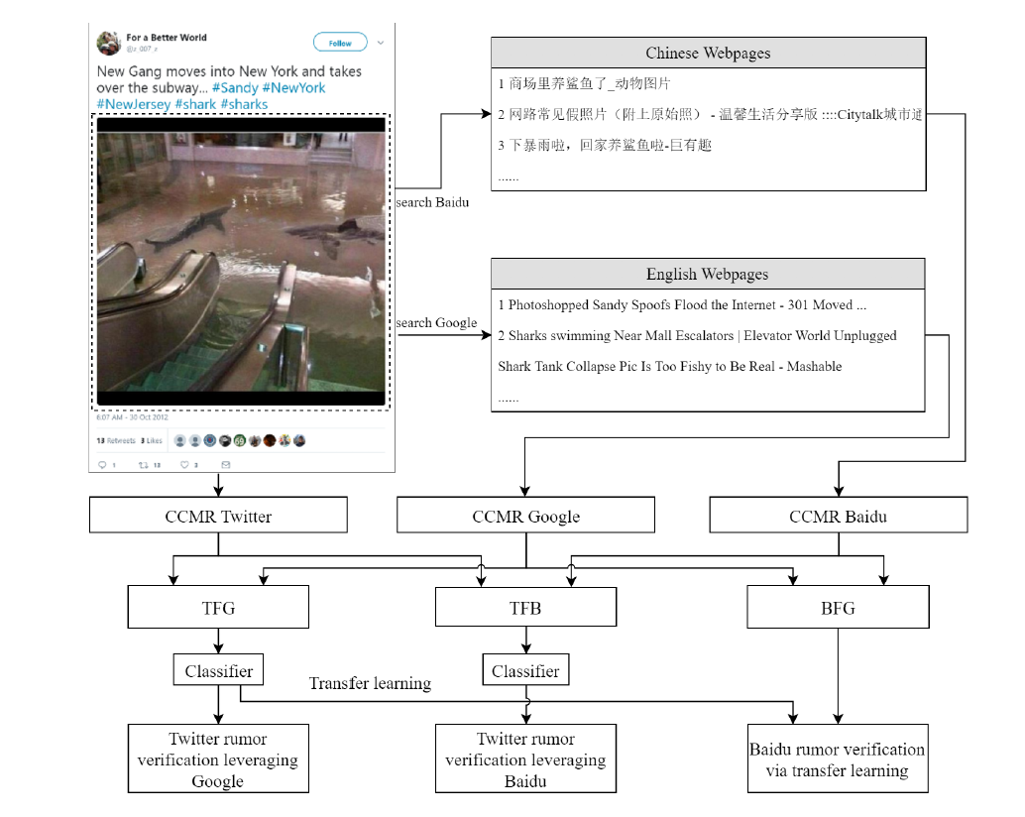
Cross-lingual Fake News Detection Pivoting on Multimedia
EMNLP 2018

Slide 31
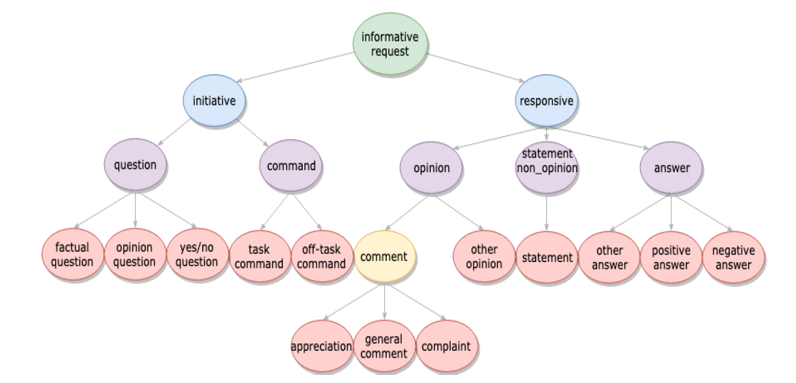
Open Domain Dialog Act

Slide 32
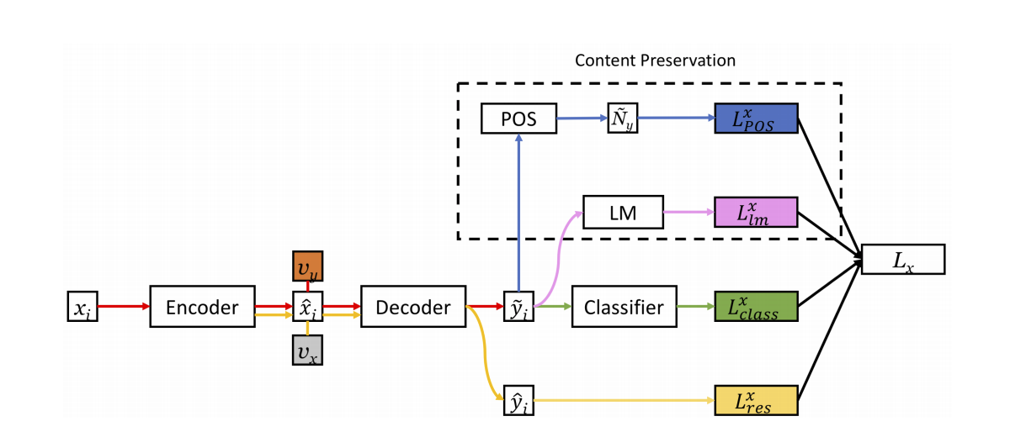
Text Style Transfer
Submitted to ACL

Slide 33
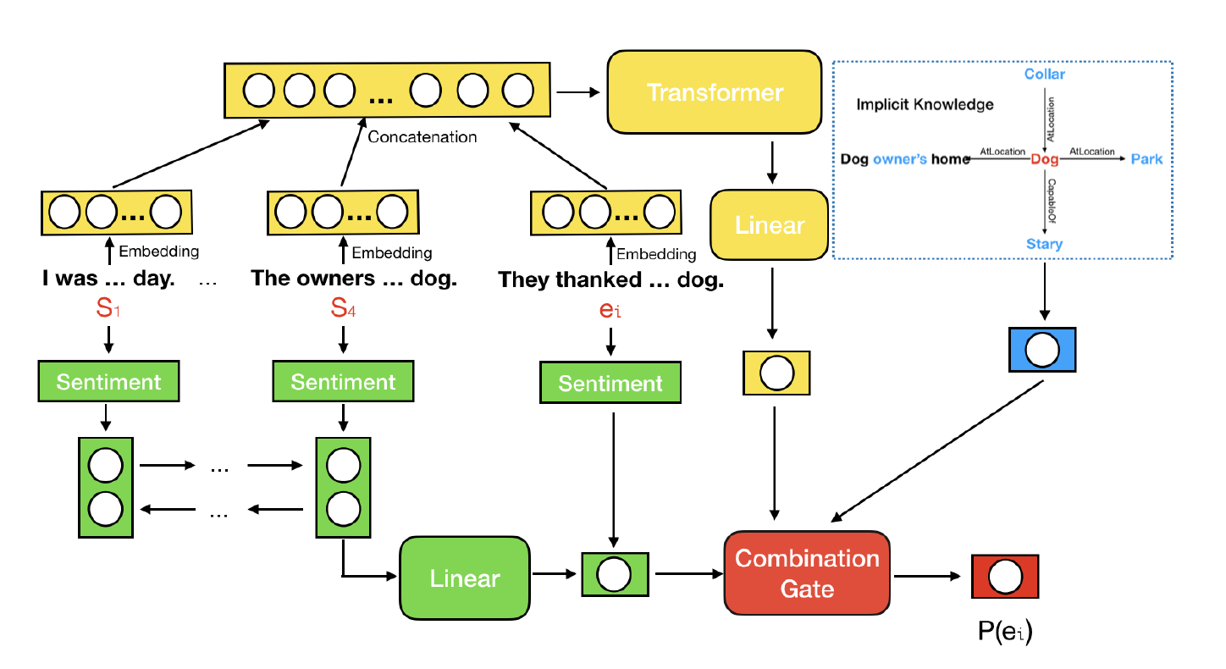
Story Completion with Common Sense Knowledge
AAAI 2019

